Slide 1
Agile Fundamentals
A Course from ThoughtWorks Studios
CONFIDENTIAL AND RESTRICTED.
These materials are for the sole use of the individuals to whom they were delivered, and any further copying or distribution is prohibited.
Notes:
Hello, and welcome to The Origins of Agile Software Development, a module in Agile Fundamentals. This module is brought to you by ThoughtWorks Studios, makers of Mingle, Go, and Twist.

Slide 2


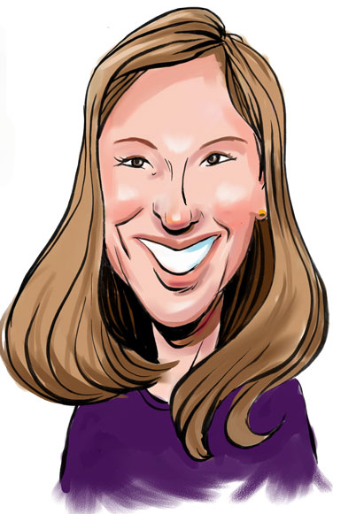
Your Facilitator
Your Facilitators
Name | David Kershaw
Role | Trainer
Email | dkershaw@thoughtworks.com
Phone | 415.525.6596
Name | Patti Mandarino
Role | Trainer
Email | patti@thoughtworks.com
Phone | 312.560.2505
www.thoughtworks-studios.com
Copyright 2010 ThoughtWorks

Slide 3

Your Facilitator
Name:
Role:
Email:
Phone:
Steven List (aka “Doc”)
Lead Trainer
doc@thoughtworks.com
+1 512 924 9248
Plan/Manage
LEGO
Dev
Fun
Core
Origins
Intro
Agenda
Notes:
TIMING: <= 2 Minutes
Introduce yourself – no more than 2 minutes – quick background, relevant experience

Slide 4
Introductions
Who are you?
What do you do?
Why are you here?
All in 30 seconds or less.
Notes:
TIMING:
Introductions: < 5 minutes
Group Juggle: 5 – 8 minutes
Follow introductions with Group Juggle…
http://wilderdom.com/games/descriptions/GroupJuggle.html
Group Juggle
Fun way to start working together.
Can be used to learn names and develop a sense of interconnectedness.
Stand in a circle, toss a ball to someone, using his/her name, and they in turn toss it to someone else, using the next person's name.
Keep it going, then more balls are introduced and it starts gets crazy.
How to Run a Group Juggle Session
Set up & instructions for 1st round of group juggling
Arrange participants in a circle, not too close, not too far from one another
Include yourself in the circle
Explain that you are going to throw a ball to someone - pick someone out & ask their name, then say
"Hi Freddy, my name is James...here you go!" [underarm throw a ball to Freddy]
Freddy then says "Thank you James", picks someone and says "Hi X, my name is Freddy...here you go!" [throw]....they say "Thank you, Freddy] and on we go.
If you're not trying to learn names, skip the naming part & just throw!
The challenge from here is simply to get the ball thrown around to everyone in the circle, and finally back to the trainer.
2nd round of group juggling
I then say, "Right, well done, now let's see if we can that again - making sure we use the same order, and using each other's names. Remember to say the name of the person you are throwing to, and thank the person, by name, for throwing it to you, OK?"
On the second round, most people will be challenged to remember who to throw it to, and the two names! Take it slow, help the group out, so that each person has a successful second round.
3rd round of group juggling
I then say, "Good, so how about we do it again, but this time, let's let's see how fast we can do it, OK? Here we go...Hi Freddy, my name is James...." [throw]
It will go pretty fast this time, and the group will probably feel quite pleased with themselves.
4th round of group juggling - introducing more balls
I then say, "That's great, but I think you can do faster than that. Come on, let's see how we can really go..." [I then throw and say the name with super fast enthusiasm to set the tone!]
After the first ball has passed through a few hands, I take a 2nd ball out of my pocket (surprise!), and casually, but earnestly say "Hi Freddy...." [throw].
By now everyone is so well trained, the 2nd ball will automatically keep going, and there will be a detectable sense of challenge/excitement.
After a bit, I introduce a 3rd and 4th ball, up to about 6 balls.
Usually I let 4 to 6 balls be juggled for a while (note the balls will be coming back again to the trainer - just keep them going). A group of 12 adults can usually handle 4 to 6 quite well.
If I'm feeling conservative, I just let the group have the success of doing this number of balls, and collect them in when that seems to have been achieved.
But usually, once the group seems competent at 4 to 6 balls I gradually then introduce an unmanageable number of balls into the juggle & maybe also weird objects (e.g., kids soft toys) which all gets crazy, fun, out of control, etc. and ends in a hilarious shambles.
Generally doesn't require debriefing.

Slide 5
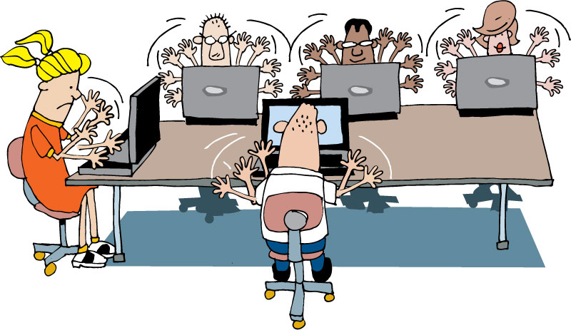
Housekeeping
Mobile phones
Laptops
Break times
Restrooms
Emergencies

Slide 6
What’s coming up…
What is Agile?
Agile Core Practices
Development Practices
Quality
Planning and Managing a Project
Notes:
TIMING: <= 2 minutes
Just a sentence or two about each topic

Slide 7
Expectation Setting
We will review a lot of concepts, practices and ideas for a shared knowledge of Agile vocabulary and practices.
This is not a custom class for your organization.
We will try to address various scenarios for implementation of these practices, but some are too complex to get into.
Specific adoption details should be addressed following this workshop.

Slide 8
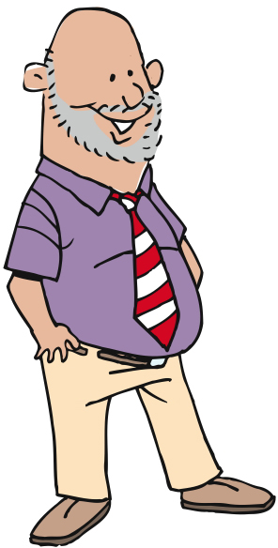
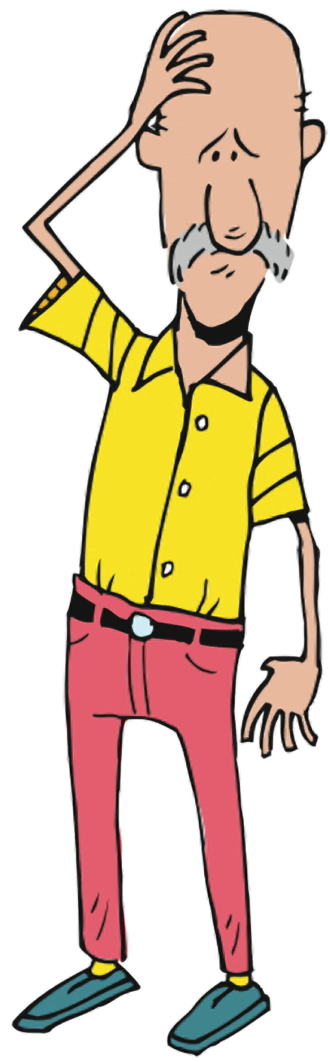
Why are we here?
Hopes
Concerns
Notes:
Capture hopes and concerns about both the course and the organization’s adoption of Agile.
TIMING: 3 – 5 minutes

Slide 9
Process Doodle
Divide into groups of 4 per group
Using materials, graphically represent your current development process.
Roles
Artifacts
Challenges
Do not use people’s names
No criticism
Have fun!
Notes:
This is so we can understand where agile techniques may apply, and may have you doing different things than you do today.
http://blog.tastycupcakes.com/2009/06/process-doodle/
Process Doodle
By Michael McCullough, on June 20th, 2009
Timing: 20 mins
Ingredients:
Whiteboards and/or flip-charts
Markers
Directions:
Divide the participants in to groups and ask them to graphically represent their current development process. Have them think about roles, artifacts produced, and challenges. Invite them to be creative and to not worry about using any formal notation (UML, Gantt Charts, RUP, etc.). Ask them not to use people’s names, or to criticize personalities.
Each team will then then present their creation to the whole group.
Learning Points:
This is an interesting and fun way for a facilitator to gain visibility in to what is working and what the challenges are in an organization’s current process.
This exercise also creates more transparency within a team, by giving people a chance to see how others characterize the process.

Slide 10
Questions?
Origins of Agile
Notes:
Thank you for joining us for The Origins of Agile Software Development, a module in Agile Fundamentals. The next module in the series is The Origins of Agile, in which we’ll look at the evolution of agile methodologies.

Slide 11
Agile Flavors – Agile or agile?
A Module in Agile Fundamentals
Notes:
This module demonstrates some of the different schools of agile, and shows how TW blends the appropriate techniques to best suit the environment we are working on without being dogmatic.

Slide 12
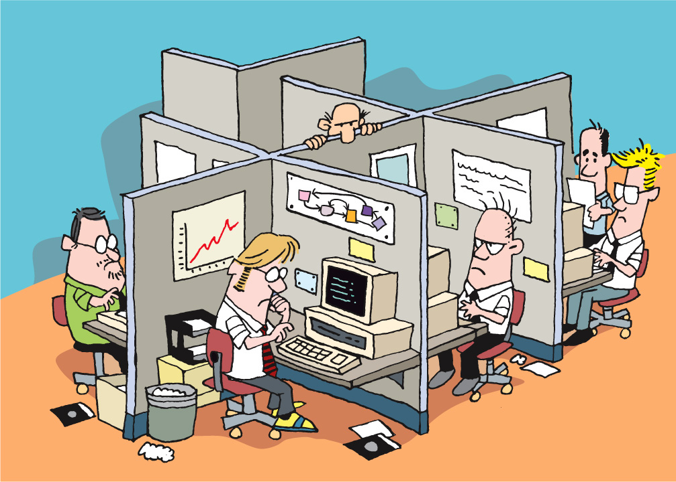
Notes:
In the beginning
Offices, cubicles, isolation
Strict hierarchy of roles – architects, designers, users, programmers, testers, PMs, BA, Build masters, tech writers
Rare to see crossover of specialties
Projects done in phases/stages.
One phase could not begin until the other was completed
It was this lack of communication and team involvement, with long development cycles that agile was born. In fact, many flavors of agile were born.

Slide 13
What Flavor of Agile?
Scrum
Crystal Clear
Extreme Programming (XP)
Adaptive Software Development
Feature Driven Development
Dynamic Systems Development Method (DSDM)
Lean Software Development
Notes:
Lots of different flavors of Agile, and we will take a look at a few of them very quickly (these are just a few)

Slide 14
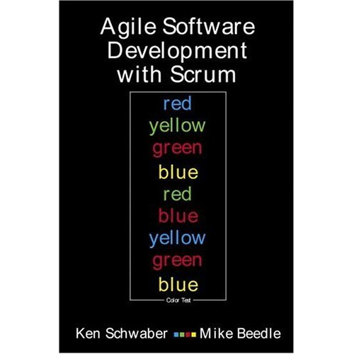
Scrum
Primarily a project management method
Project planning
Release planning
User Stories
Daily stand-up
Story points
Velocity
Notes:
Kent Schwaber developed in the late 1990’s
Approach to plan, monitor, and manage projects
Widely used

Slide 15

Extreme Programming (XP)
Primarily a developer-centric approach
Test Driven Development (TDD)
Unit tests
Pairing
Continuous Integration (CI)
Refactoring
Notes:
Kent Beck, also developed in late 1990’s
Primarily developer focused, although it shares many of the same beliefs as scrum for team dynamics and planning
Also widely used

Slide 16
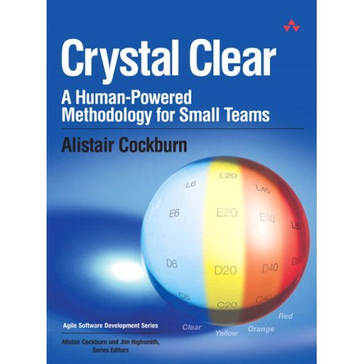
Crystal Clear
Focuses on people, not methods or artifacts
Teams of 6 to 8
Co-location
Reflective improvement
Team safety
Singular focus
Notes:
Alistair Cockburn
For non-critical, small-team, focused and dedicated development
Focuses on team dynamics, individual “belonging”, experimentation, allows failure

Slide 17

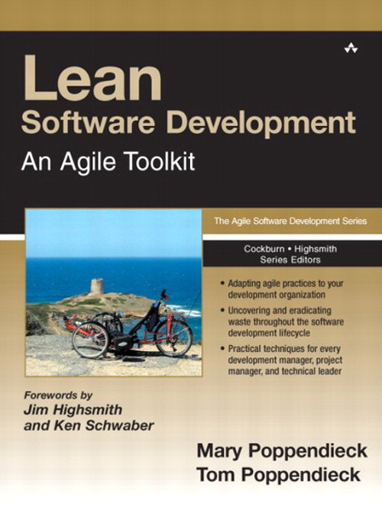
Lean Software Development
Optimize the whole
Eliminate waste
Build quality in
Learn constantly
Deliver fast
Engage everybody
Keep getting better
Notes:
Mary Poppendiek (“pop – en – dike”)
Grew out of manufacturing, primarily the Toyota Production System
Focuses on eliminating waste throughout the entire process, while building-in quality

Slide 18
So What?
Goal
Fundamentals
Ceremonies
Techniques
Iterations
User stories
Training
Co-location
Deliver high-value, high-quality working software quickly and frequently
Short feedback loops
Task cards
Project kick-off
Story board
Burn chart
Release planning
Grooming the backlog
Inspect and adapt
Iteration planning
TDD
Collaboration and teamwork
Planning poker
Daily stand-up
Done-done-done
Review / demo
Pairing
Unit tests
Retrospective
Participate
Continuous integration
Notes:
We combine the best elements of all agile approaches, so when we talk about “agile” it can mean a range of things.
But the focus is always the same – delivering business value effectively and quickly
Don’t be fooled into thinking that if you do all the things on the right that you are agile – if you are not delivering business value, you have lost the plot.

Slide 19
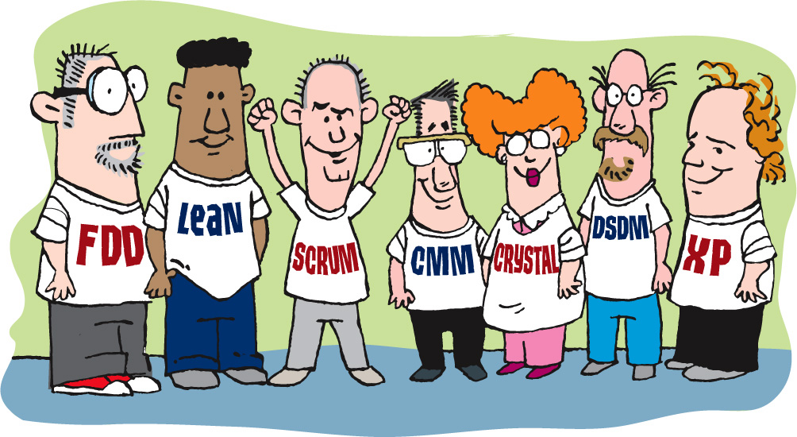

We Are Going to Look at:
Planning – project, release, and iteration (sprint)
Metrics
Pairing
Quality
The team and its organization
Executing through iterations (sprints)
Notes:
We will learn how to organize, start, and execute a project using agile, using those techniques and approaches that are most useful here, rather than being focused on any single agile methodology.
Need to be pragmatic, practical, and discover what works best

Slide 20

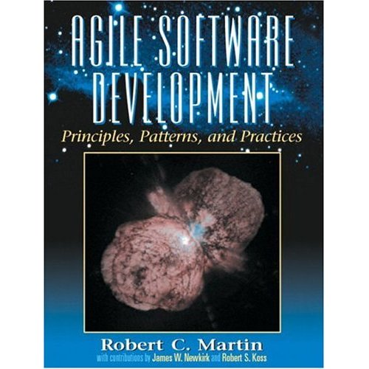




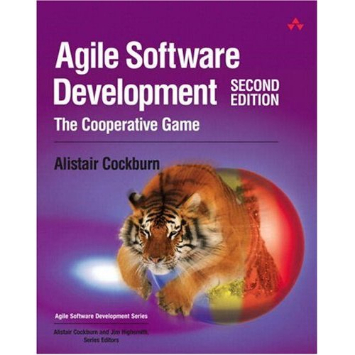

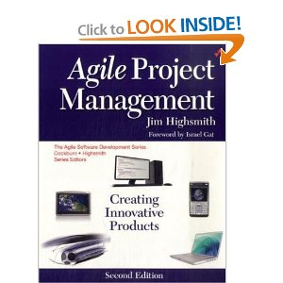

Notes:
There are lots of books on the subject of agile development, and you may want to reads some of them for yourself.

Slide 21
The Agile Manifesto
Following a Plan
Processes and Tools
Contract Negotiation
Working Software
Comprehensive Documentation
Individuals and Interactions
Customer Collaboration
Responding to Change
Notes:
Now for a little bit of fun. You each have a worksheet that contains the key concepts that make up the Manifesto. There’s a template on those worksheets, showing how the ideas go together. Let’s take a few minutes to see if we can figure out what the signers of the Manifesto had in mind.
Building the Agile Manifesto
Don't just simply present the agile manifesto. The students will learn more if they have an opportunity to build it. Ensure that your flip chart has the four empty slots for all the statements as well.
Hand out copies of the empty Agile Manifesto (see Student's Handout). Feel free to ask students to work together in pairs or individually. Explain the manifesto is used as a guide for values and that everything on the list is important and we're trying to understand what factors might influence the decisions we make.
Give them five minutes to fill out their form. Build up the manifesto based on everyone's input and discuss why one item appears on one side, and why they are trade offs.

Slide 22
Notes:
What do these ideas mean to us?
Something over something else
Not instead of
Both sides have value
Items on the right have value BUT
We value the left items more
-------------------------------------------------------------------------------
Let’s talk for a few minutes about the four key ideas these folks wrote into the Agile Manifesto, and what they mean to us.
First, we’ll consider the wording. Note that every one of these is phrased as something over something else. That’s not instead of or is better than. No, it’s over. That means that both sides of the statement have value, and that the folks who authored the Manifesto were expressing a preference for one over the other.
In fact, what you don’t see on this illustration is the sentence that comes after the four points in the manifesto: “That is, while there is value in the items on the right, we value the items on the left more. “
Now let’s look at them one by one…

Slide 23
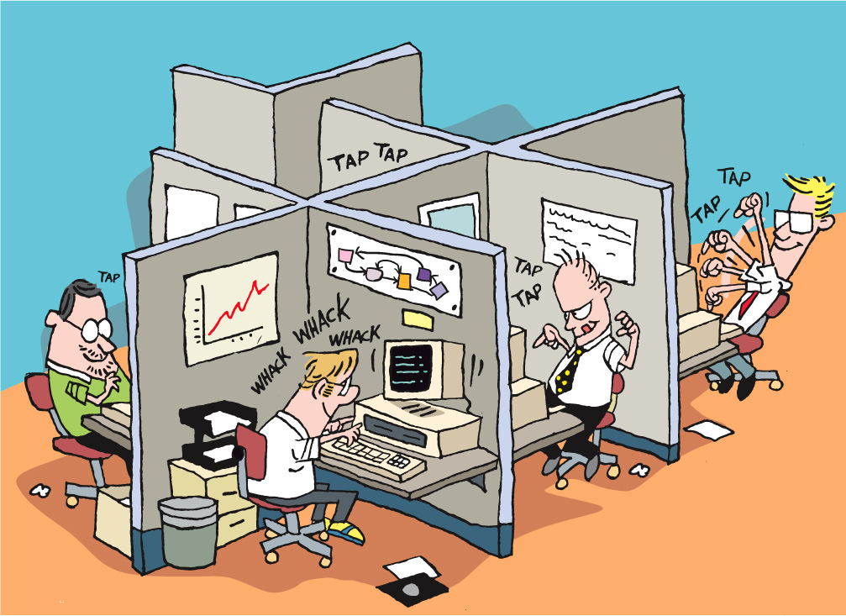
Notes:
Discussion:
How do you feel about getting out of your cubicles and moving to a teamroom environment?

Slide 24
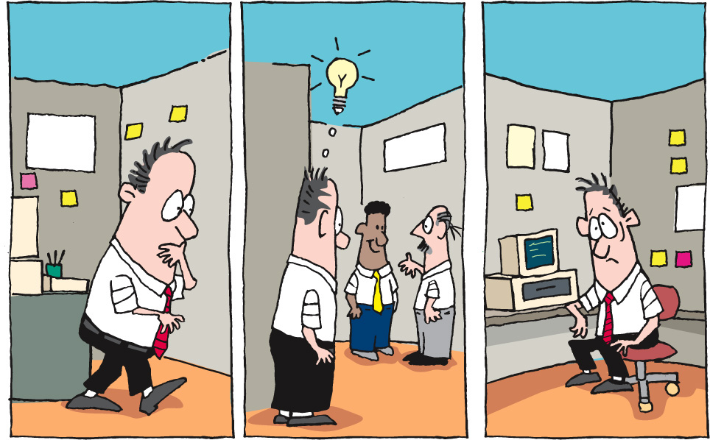
Notes:
Instead of getting up to find someone
Losing time and context
[CLICK]
Consider our previous example, where I have to get up, walk around, find someone to answer a question, go back to my office or cubicle, remember what they said… Well, there’s a lot of time and knowledge lost, and productivity is not very high. What if, when I wanted to ask someone a question, they were right there in the room with me? What if I could just ask, immediately use the answer, ask clarifying questions, all without leaving my work space?

Slide 25
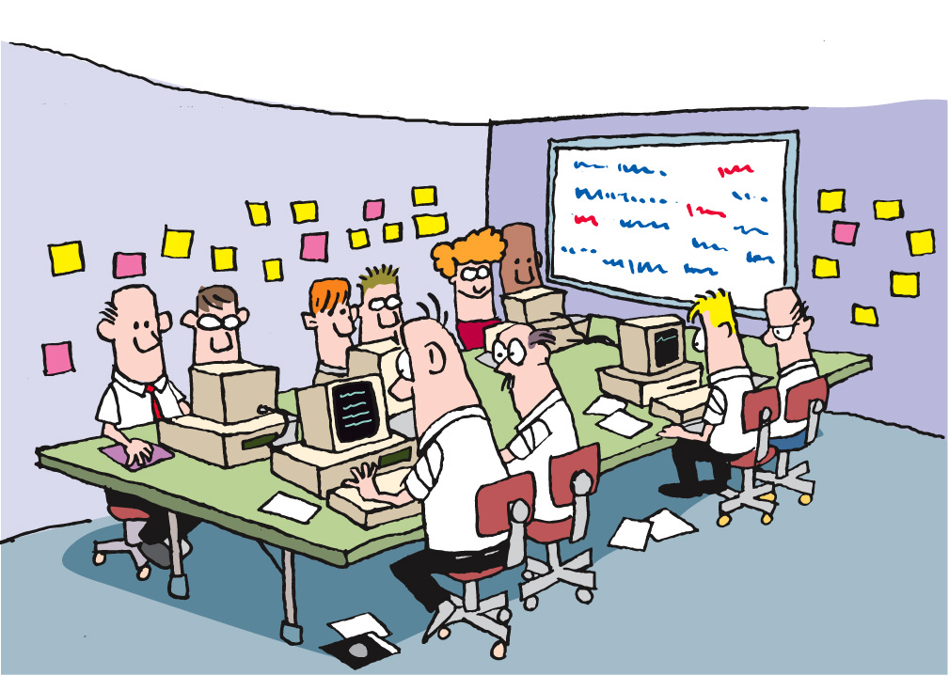
Notes:
I just pick my head up and ask the question
Get an answer
Follow up question
Back to work
Productivity goes up
Quality goes up
Time goes down
What about code reviews?
Long after the code was written, tested
Change was resisted
Feedback taken as criticism
What if my reviewer was working with me?
Talking to me while I code
Pairing with me
-------------------------------------------------------------------------------------------------------------------------
The answer is that productivity goes up, the quality of the work goes up, and the time it takes goes down.
Now, let’s look at another part of this. In the old days (yes, we’re still talking about times as recent as yesterday), code reviews were a separate process, conducted with some degree of formality. They usually took place after I’d written and tested my code, when I thought I was done, and when I thought I was ready to move on. Because we had to schedule and arrange and plan the time, code reviews frequently took place some significant time after I thought I was done. Changes were resisted, and feedback was always taken as criticism.
What if code reviews were happening in real time? What if my reviewer was actually sitting right next to me, talking to me about my code, the decisions I’m making, and so on, as I’m writing my code? And what if we changed roles periodically? This is Pair Programming, and is another outcome from the C3 project, and a core practice in XP.

Slide 26
Questions?
Agile Core
Notes:
What we’ve done……
Seen how best practices address traditional project challenges
Learned the process
Met the team

